Slide 1


AI FOR ALL CHALLENGE
TITLE PAGE
    Problem Statement Title:-AI Powered Smart Surveillance and Alert System
    Theme:- AI for Social Impact
    Team Name:- Pyro
    Team Leader Name:- Divyanshu Swain

Slide 2
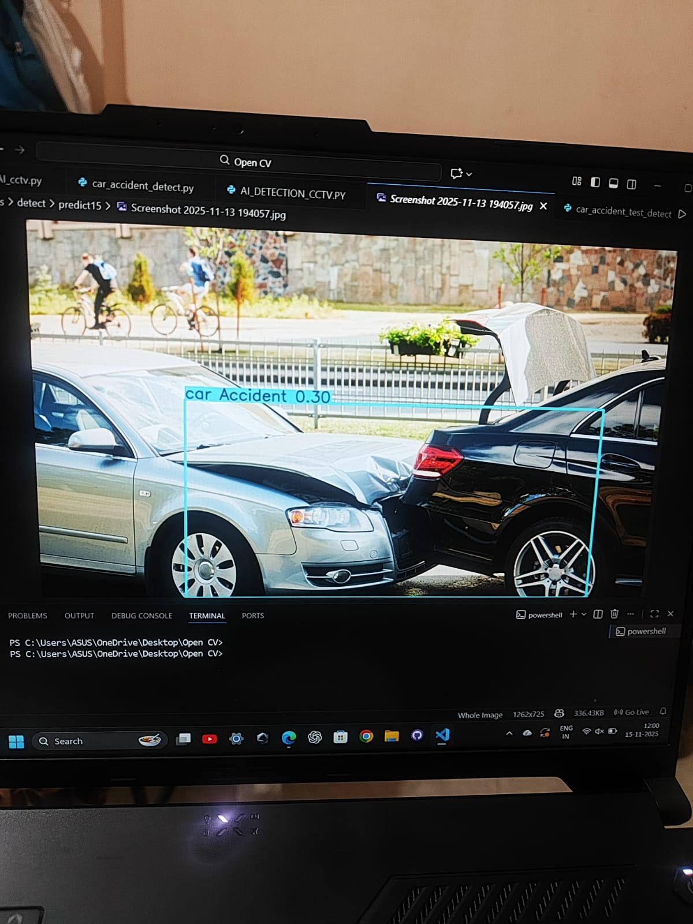
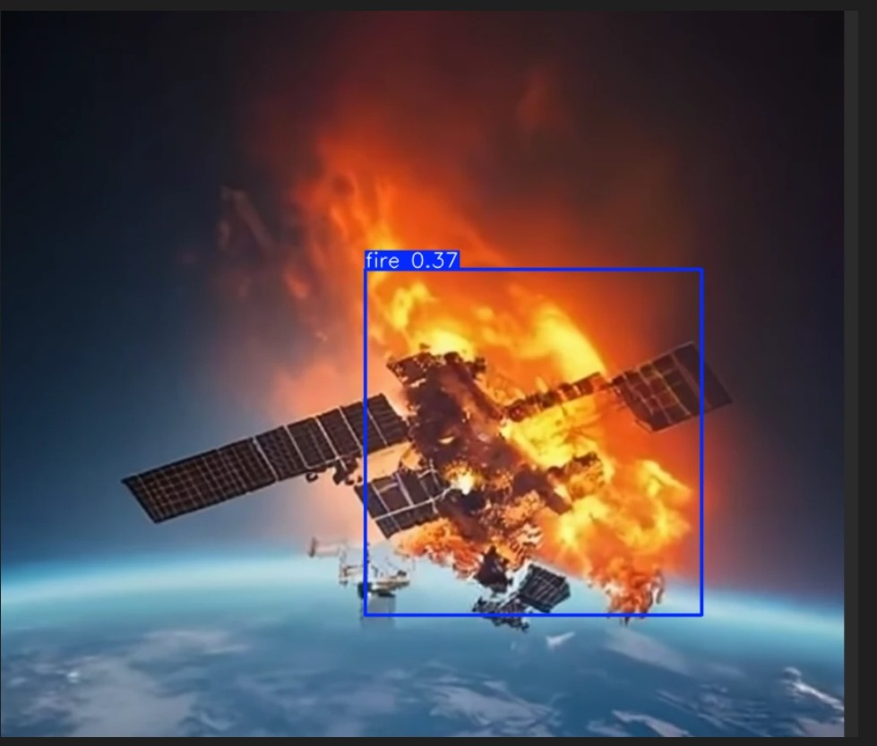
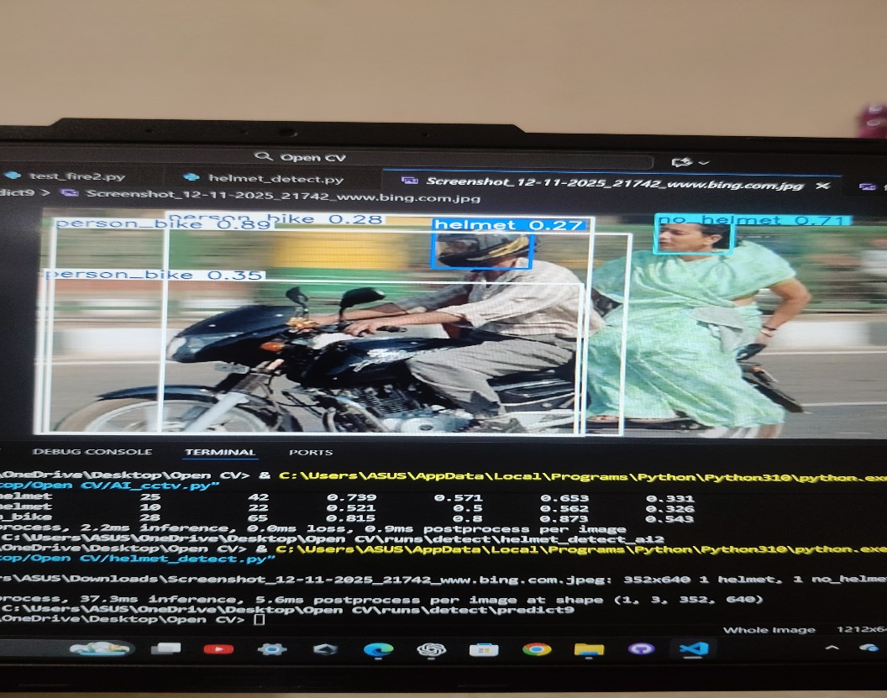
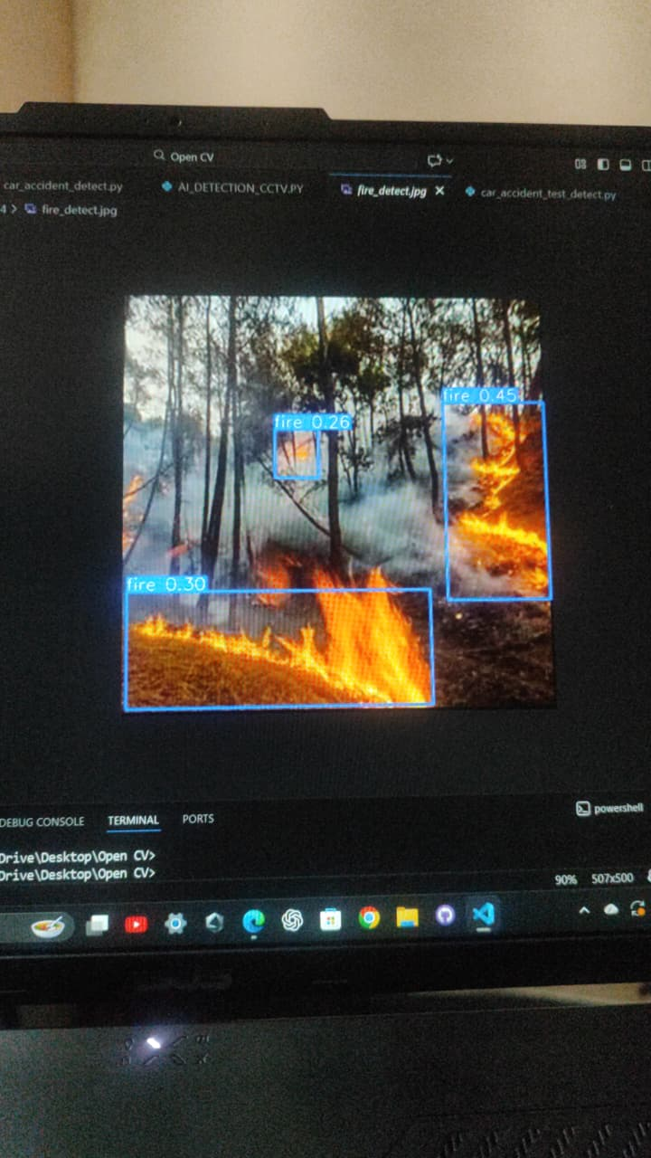
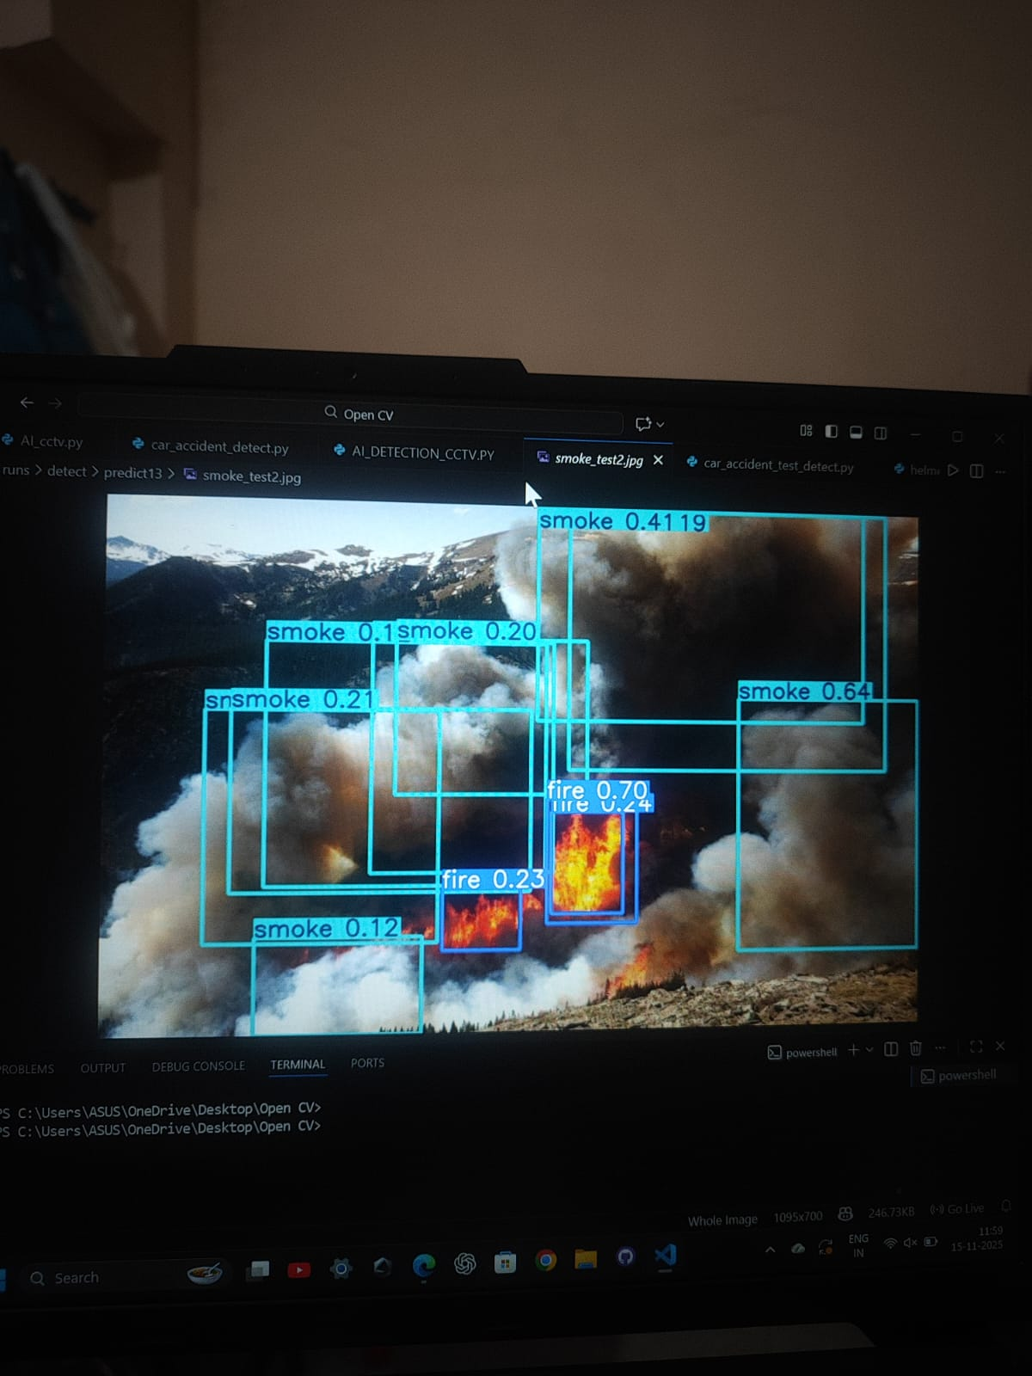
AI FOR ALL CHALLENGE
IDEA /APPROACH DETAILS
    The project addresses the need for an AI-powered surveillance system that can analyze live camera feeds, detect critical events, notify users, ensuring faster action.
    AI Automation > Traditional CCTv
    Over 80+ event detection like:
    Fire
    Smoke
    Accidents
    violations
    DEPARTMENTS OF: Traffic, Road safety, Law, Wildlife and Forest, Disaster management, Industries and Factories, Smart City Administrations, General Public and Space organizations.

Slide 3
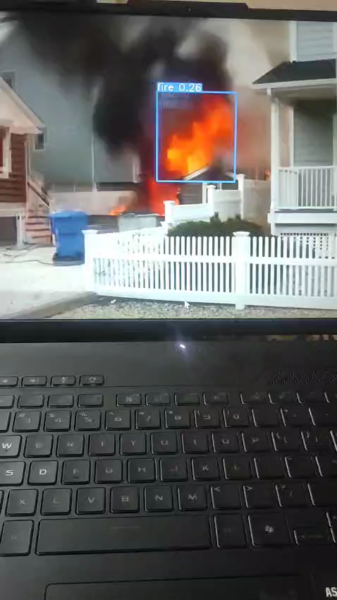
AI FOR ALL CHALLENGE
TECHNICAL APPROACH
    Tech Stack:
    AI/ML: Python 3.10, TensorFlow/PyTorch, OpenCV, YOLO, NumPy/Pandas.
    Backend: FastAPI/Flask. Deployment: Render/Railway + GitHub Pages.
    System Flow:
System Flow::
Workflow:
Capture live video
User gets notification
Camera feed
Alert Generator
User Notification
AI Detection model
Dashboard instant alerts
AI detects events
API Backend
Event Classification
Alert (JSON) Backend
Classify event
Dashboard

Slide 4
AI FOR ALL CHALLENGE
FEASIBILITY AND VIABILITY
    Public Safety: Instant detection of accidents, fire, and hazards
    Government & Police: Cuts manpower load, reduces corruption, ensures unbiased automated monitoring.
    Forests & Wildlife: Early fire alerts, better wildlife tracking, reduced illegal activities.
    Industries & Smart Cities: Real-time hazard alerts.
    Remote / Space Use: Works in dangerous or inaccessible environments.
    Overall Benefits:
    Safer cities, faster responses, Lower monitoring cost, prevents major losses.
    Early fire control, reduced fuel-based patrolling. Scalable AI system for future smart-city & research needs.

Slide 5
AI FOR ALL CHALLENGE
CHALLENGES AND LEARNINGS
Challenges:
• Python version issues caused library errors & slow model training.
• Managing thousands of images was time-consuming.
• Large, complex codebase was hard to debug.
• API → dashboard real-time integration issues.
Solutions:
• Upgraded to Python 3.10 for ML compatibility.
• Structured datasets + automated preprocessing.
• Modular code + documentation for easier maintenance.
• Stable FastAPI /Flask backend for real-time alerts.
Learnings:
Strong teamwork & task division, Training & optimizing AI models, Debugging camera, model, and API issues, Handling large datasets efficiently, Using GitHub.

Slide 6
AI FOR ALL CHALLENGE
RESEARCH AND REFERENCES
    NAME TYPE LINK
    OpenCV Documentation https://docs.opencv.org/4.x/
    NumPy Documentation https://numpy.org/doc/
    Roboflow Training Dataset https://public.roboflow.com
    Datasets used [Fire, Helmet, no helmet, Car accident, Smoke, etc]:
    https://app.roboflow.com/yash-karn/fire-and-smoke-detection-hiwia-amh6u-exebn/1
    https://app.roboflow.com/yash-karn/helmet-motorcycle-detection-pro0q-r6qgl/1
    https://app.roboflow.com/yash-karn/no-helmet-detection-qhw6v-b1oqj/1
    https://app.roboflow.com/yash-karn/car-accident-jp29y-fphyg/1
    https://app.roboflow.com/yash-karn/fire-and-smoke-detection-hiwia-amh6u-exebn/1

Slide 7
AI FOR ALL CHALLENGE
TEAM MEMEBERS
    NAME:
    DIVYANSHU SWAIN
    JAI MALL
EVERYONE IN OUR TEAM SHARED ALL THE RESPONSIBILITIES EQUALLY WHETHER IT WAS TRAINING THE AI MODEL,CREATING THE WEBSITE,OR INTEGRATING IT WITH API. THANK YOU

